Slide 1


Slide 2
Table Of Contents
Mission Statement & Our Values
Admissions
Arrival & Departure
Withdrawal & Discharge Policy
Yum! It’s time to Eat! - Food Program
Payment Policies
General Policies/Code Of Conduct

Slide 3
Mission Statement and Our Values…

Slide 4
Our Mission Statement
At Blue Dragon Academy, we believe each child has the potential to bring something unique and special into the world. By having a respectful and caring bond with both the student and the family, we can create a strong foundation for a wonderful early childhood experience for our students. Through active exploration of the world around them, play, interaction with others, memorable experiences, and hands-on learning activities, our student’s development and growth occur every second of every day. Our mission is to provide a safe, nurturing, exciting, and quality learning environment for all. Our love for children is why BDA and why we remain open to this day. Committed to the families we serve, we strive to give parents the feeling that their child is in the care of the most loving, knowledgeable, and thoughtful child care providers each day. Children deserve to feel special, loved, adored, and cherished. They deserve to participate in experiences that will change their lives and BDA promises to provide the environment to make this come true!
We believe that the family is the most important aspect of a child’s life. As a partner to parents in their child’s care, we realize the importance of providing an atmosphere of open and honest communication, information, cooperation, and support. We will serve as a resource to families as the children grow into self-sufficient, dependable, and competent adults.

Slide 5
Our Values
Our values consist of the following but are not limited to:
Quality – We believe every child deserves excellence in early learning programs and services to make a difference in their lives and our community.
Inclusion – All children are included in our learning environment. We welcome all with open arms and love in our hearts.
Respect – Respect is essential in building relationships with children and families that last a lifetime. Respect is a key component of our work as it helps to optimize the talents and diversity we bring into BDA as partners in the child’s growth and development.
Accountability – We pride ourselves on providing open communication with all parents. This allows us to be transparent, open, and honest with one another and, in turn, provides the best environment for children at home and at BDA.
Teamwork – The combined action of the childcare providers and the families working together provides an effective and efficient working relationship. By acting together as a team, we are working toward the best interests of our common cause, which is for our little ones!

Slide 6
Admissions…

Slide 7


Slide 8
Admissions
01
02
03
04
Enrollment Requirement​
Supplies List for First day!
Registration Documents
Enrollment
Fees
To enroll your child at BDA, your child must be between the ages of 6 weeks-12 years old.​ Find our Enrollment application on our Website under ENROLLMENT.
Prepared Bottles
Sleep Swaddle
Spare Pair of clothes.
Nap mat
Family photo
Weather appropriate wear
Enrollment packet filled out.
Tuition paid
Medical Info filled out
CACFP form
Immunization records
1 month schedule
One Months Tuition Paid
One week Credited to Account

Slide 9
Arrival/Departure Policy…

Slide 10
Arrival Procedure
Upon arriving at the school, parents must pull up in the designated pick-up and drop-off spot in the front of the building. Parents must walk their child their designated classrooms. Please make sure teacher is in classroom and do not leave child alone in classroom. The teacher will be ready to sign the child in. Parent, please assist children in putting items away in cubbies. Drop-off time is between 6am and 9am If you are going to be later than 9am you must call . No children will be allowed drop off after 11am. ​

Slide 11
PICK UP AUTHORIZATION ​
For the child's safety, the only people authorized to pick up a child are those designated by the parent/guardian on the child’s approved pick-up list. If a child is to be released to anyone other than the person(s) listed, a written note, message from parents, or verbal communication authorizing pick-up must be received prior to pick- up time.​
Pick-Up Authorization Process:​
Parents/guardians must BDA (call, leave a note at drop-off) of the name of the person who is picking up their child on any day when they themselves are not.​
The “Authorized Pick-Up Person” must be at least 14 years old and may be asked to provide photo ID to the staff.​
This authorization shall remain in force until edited or rescinded in writing by the signer of this authorization.​

Slide 12
DEPARTURE PROCEDURE​
Upon picking up your child, you are responsible for grabbing their belongings daily.​
This includes nap time items, artwork, and other personal items. Please check parent files. ​
For safety of children, they may not be left unattended in the building or parking lot. Children must be picked up directly from area they are in and parents need to communicate with CHILD’s TEACHER, that their child is leaving for the day. ​
Parents must always have children with them. ​

Slide 13
Lets Eat! Food Program…

Slide 14
Food Prep-
All Children of BDA is part of CACFP. ​
Food Service is supervised by our Food Program Manager
Breakfast
Giraffes,Elephants, Alligators 8am-830am
Tigers, Monkeys 830-9am
Lions 630-715am School Year
No school/Summer 9-930am
Lunch
Giraffe/Elephants 11-1130am
Tigers 1130-12pm
Monkeys (and Lions No School) 12-1230
PM Snack
Giraffes, Elephants, Alligators 245-315pm
Tigers, Monkeys 315-345pm
Lions 345-415
Meal Times-
Menus-
All food menus are posted in the kitchen, walkway entry, classrooms, and on Playground app. ​

Slide 15
Children With Special Diets​
• If a student has an allergy or dietary restrictions, please inform the school immediately. Parents/guardians must notify the Food Program Manager in writing, and this is kept in the child’s file. This information is also posted in BDA classroom for all to be aware of. ​
• Depending on the method used in allergy emergency situations, parents may be asked to complete a Food Allergy Information form and provide Dr Note.​

Slide 16
Food From Home
BDA will not provide the food needed for a special diet, meals or portions. Parents will be responsible for providing food. Perishable food will be refrigerated upon arrival. Special foods provided by parents must be clearly labeled with the child's name, date, and identity of the food and will not be shared with other children. It is the parent’s responsibility to ensure the student has food at the school every day.​
​
Children may not bring food from home into BDA. ​

Slide 17
School Celebrations​
BDA loves to celebrate your little one during the school day! Parents/guardians must notify the administration or the classroom lead teacher to the celebration to discuss the classroom and school food restrictions and policies for bringing in outside treats and snacks. ​
​
BDA is a nut free facility and all items must be prepackaged and store bought. ​

Slide 18
Payment Policies…

Slide 19
Monthly Calendars
Calendars for ALL children are due by date on link at closing time. ​
We use these to schedule staffing according to the number of children in attendance daily. ​
A JotForm link will be sent out through a message on the Playground Engagement app.​
Families who have not returned calendars by due date will be charged a $15 late fee.​
If there are any changes to your submitted calendar, we ask that you communicate with your child’s room teacher or center director.​
If calendars are not turned in by the end of the month, we will mark your child as not coming for that month until calendar is submitted. ​

Slide 20
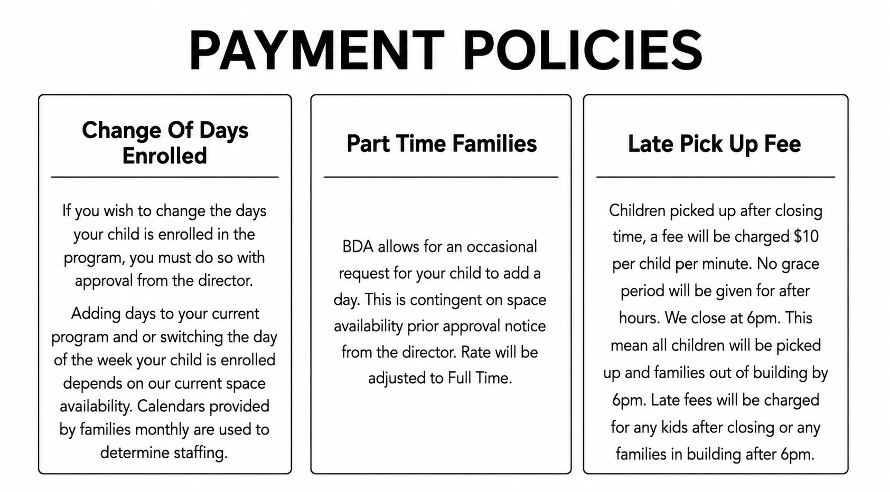

Slide 21
BDA’s late payment charge policy​
​
If payment is not made the last open business day of the week at close, a $50 late fee is assessed and added to the next week charges. ​
If you are going out of town, please plan for paying tuition. Late fees will be assessed even when child isn’t in attendance. You can use Playground to pay when you aren’t able to drop off. ​
Blue Dragon Academy’s absent policy.​
​
Blue Dragon Academy does not offer tuition refunds or make-up days. Exceptions are assigned free days
If parents do not call or message before 9 AM, their child(ren) will be marked absent for the day. ​
We ask all children to be in attendance by 9am to enjoy a full day of learning and fun activities. ​

Slide 22
Withdrawal/Discharge Policy…

Slide 23
Withdrawing from the Center​
If you wish to withdraw your child from BDA, a 2 week(14 business days) written notice is required. If you fail to provide a 14 day notice, you will be charged for 4 weeks. ​
Discharge Policy​
BDA has the right to terminate a child’s enrollment under specific circumstances. These circumstances include any child who, after many attempts, does not progress in their behavior and whose behavior affects the large group. This also includes any child whose needs cannot be met by the school’s philosophies. Before termination, many attempts will be made to help the child thrive in our environment. These attempts include observation notes, therapy referrals, and tactics to be used at home and onsite at the school.

Slide 24
General Policies

Slide 25
COMMUNICABLE DISEASES & ILLNESS
Blue Dragon Academy follows South Dakota DSS health & communicable disease guidelines.
🚫 When to Stay Home
Fever of 100°F+ (underarm)
Vomiting
Diarrhea/loose stools 2+ times in 24 hours
Symptoms of a communicable disease
Child is too ill to comfortably participate
🏠 Returning to BDA
Fever-free for 24 hours without medication
Normal bowel movements have resumed
Child is no longer contagious
Doctor’s note may be required stating child can return
📞 Please Notify Us
Let the Center Management know when your child is absent due to illness
Report any diagnosed communicable disease
Illness information is kept confidential and shared only as needed
💙 Our priority: Keeping children, families & staff healthy!

Slide 26
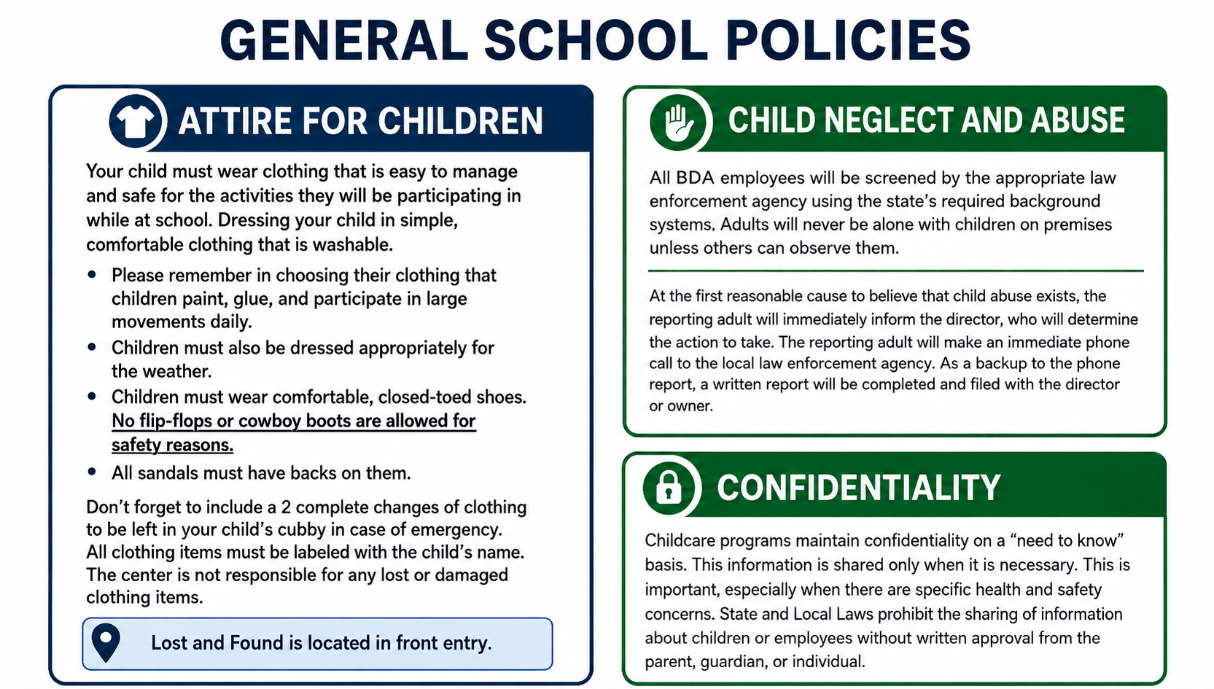

Slide 27
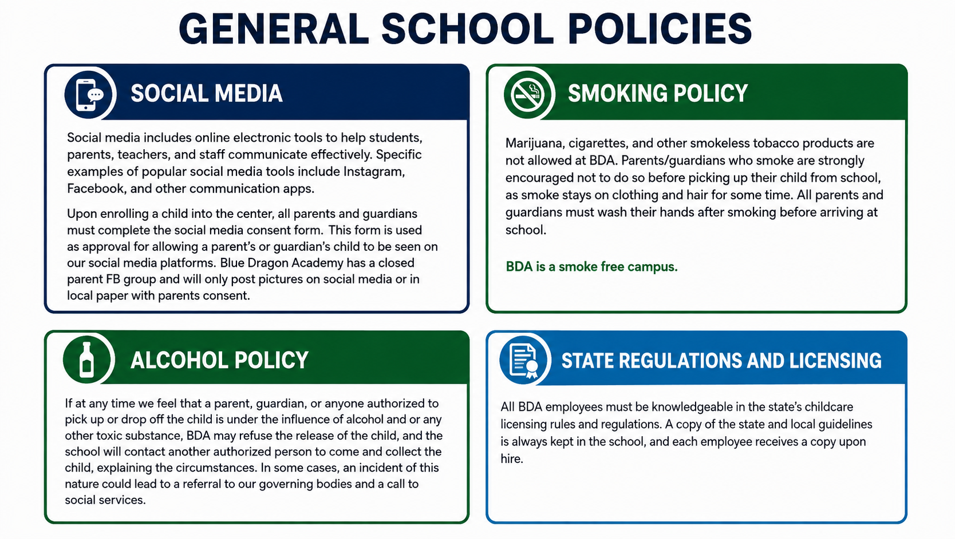

Slide 28
